Slide 1
Erasmus+ project: A Better Life: Social inclusion in the Czech Republic

Slide 2
Definition
Social exclusion is a multidimensional phenomenon not limited to material deprivation; poverty is an important dimension of exclusion, albeit only one dimension. Social inclusion processes involve more than improving access to economic resources.
Social inclusion is defined as the process of improving the terms of participation in society, particularly for people who are disadvantaged, through enhancing opportunities, access to resources, voice and respect for rights.

Slide 3
Obstacles and risks of social inclusion in Czechia
1.There are 2,158 social service providers in the Czech Republic who have registered 5,836 types of social services Nevertheless, the capacity and availability of social services is still inadequate. The unavailability results from a lack of local social service planning which does not respond to adverse social events identified in the relevant territory. Also, the coverage of social services in the Czech Republic does not sufficiently reflect the level of risk of social exclusion, which is due, inter alia, to insufficient tools for ascertaining the level of risk. It is desirable to configure the system of financing social services so that it does not encourage societal concerns about the preferences for certain legal and ownership forms of organizations over others.
2.Significant differences in quality of social services in a locality for the purpose of social inclusion or prevention of social exclusion.
3.Unsustainable systém Of financing social services: With regard to demographics, the demands of the users and the ever-increasing costs of providers, the current system of financing social services is unsustainable. The problem is the fragmentation of resources and unclear funding constraints.
4.Personnel "inconsistencies" of social services:-accumulation of jobs (social worker / worker in social services, social worker / administrative aide, social worker / medical staff, social worker / psychologist, social worker / educator);-unclear competencies of jobs in social services (e.g. social worker does shopping, worker in social services does individual planning, etc. ...);-lack of career structure in social services;-fragmented and unsystematic education of social services workers.
5.Insufficient communication between theory and practice: The issue of social inclusion and prevention of social exclusion is widely thematized academically, but its results are rarely taken up in the practical provision of social services due to the lack of communication between the "theorists" and "practitioners" (including public administration).

Slide 4
Family support
Family support is part of the investment in human capital, which is also produced in the family; as a result, in terms of social inclusion, the family is essential for cohesion and further development of the society. As mentioned in the introduction, children and families in the Czech Republic represent a substantial group significantly at risk of poverty and social exclusion. Although international comparison show that the Czech Republic leads the EU in general indicators of poverty and social exclusion, it placed only eleventh in terms of social exclusion and child poverty in 2011, despite still being below the EU average.42 In the case of families with children, the effectiveness of social transfers is low, ranging from 27% in single-parent families with children to 63.7% in two-parent families with one child (the average efficiency of social transfers in poverty elimination is at 74%, and even over 90 % in the case of pensioners). This represents an unsatisfactory situation, as children present a significant risk for Czech families in terms of income poverty and material deprivation.In recent decades, family life has also undergone many changes, which are documented by a number of research programmes and projects.

Slide 5
Promoting equal access to education
The quality of pre-school and primary education is an important determinant of a person's educability in later life and an essential factor for social integration. It helps to reduce social gaps and represents an effective measure to substantially reduce the costs of future social policies. Investing in quality and widely accessible initial education constitutes huge savings of future social spending. However, compared to other countries, Czech education is underfunded (low expenditure per pupil / student relative to GDP per capita in purchasing power parity).50Educational structure in the Czech Republic is characterized by a high proportion of people with secondary education. In 2010, they accounted for 69.6% in the 25–64 age group, while the share of persons with tertiary education is below the EU average, which is confirmed by the 2010 OECD report. According to the report, only one in eight Czechs has completed tertiary education, while the average share of university-educated people in OECD countries was 25 %. There are less female than male university graduates (12.7% vs. 14.8%); however, women dominate among university graduates in the youngest generation. 51The time spent by young people in the Czech Republic in the educational system has significantly prolonged, which has its negative and positive aspects. The Czech Republic also shows a record-low rate of early school leavers (the share of people aged 18-24 who have only lower secondary education and do not continue in further education or training.

Slide 6
Education system and social inclusion
Czech education system is not able to adequately compensate handicaps of disadvantaged pupils and develop individual potential of each pupil. Problems persist not only in the case of children from socially excluded or vulnerable groups –low ability to diversify education and individualize affects every pupil, including gifted and talented ones.In many cases, however, there is unjustified and premature selection of children, where its negative impact is likely to outweigh the positive. This selection is due to limited availability of childcare facilities, dividing children upon commencing elementary schools widely varying in quality, or commencing grammar schools. According to international comparisons, differences among children in different schools in terms of their study dispositions are very high in the Czech Republic. A high proportion of Roma pupils are educated in practical elementary schools(former special schools), indicating a high degree of selection of children based on their ethnicity. The share of Roma pupils reported in the curriculum for basic education with a supplement on the education of pupils with mild mental disability has decreased by 8.6% since 2009/2010 in the surveyed schools, which indicates a positive trend initiated by the amendment to Decree No. 72/2005 Coll., on the provision of counselling services in schools and school counselling facilities, as amended by Decree No. 116/2011 Coll., and No. 73/2005 Coll., on the education of children, pupils and students with special educational needs, and exceptionally gifted children, pupils and students, as amended by Decree No. 147/2011 Coll. The Czech Republic adopted measures seeking to set conditions which ensure respect for the needs of socially disadvantaged pupils and pupils with a diagnosis of mild mental disability. However, a number of basic mainstream schools still lack adequate conditions for the education of these children in mainstream classes.

Slide 7
Non profit organization in the Czech Republic
People in Need

Slide 8
People in Need

Slide 9
People in Need

Slide 10
What do they do?
Education and awarness
Joint education – school asistants, inclusion
Global development education
Migration
Stories of injustice
Media education
One world festival
Social work and counselling
Support for families and individuals
Support for children
Advocacy activities

Slide 11
Social work and counselling

Slide 12
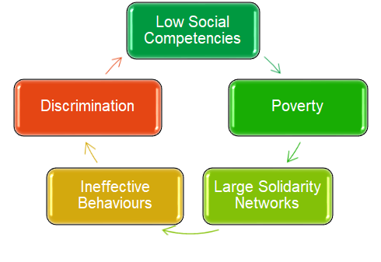
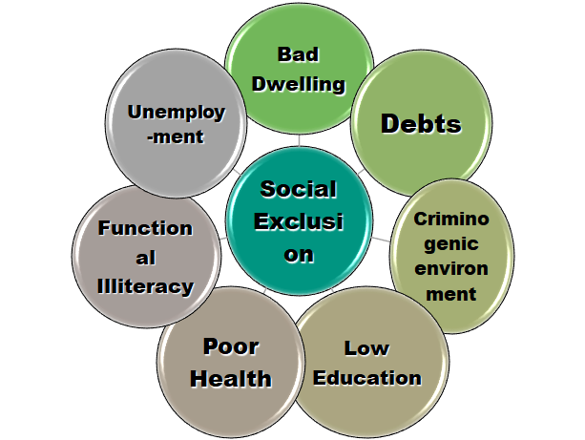
Support for families and individuals Support for children

Slide 13
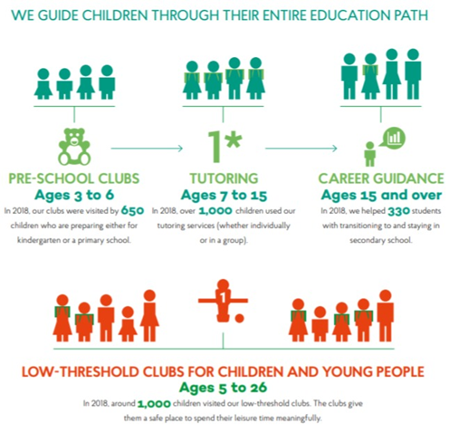
People in Need

Slide 14
Moravian High School, Ltd.
Projects for supoorting social inclucion from the Ministry of Education + Ministry for Social Affairs, especially for Gypsy students and students with weak social background
Lending of studying materials
Lending of notebooks
Schedule of instalments for tuition

